Slide 1
Modern art and modern Architecture
Characteristic and Culture

Slide 2
Concept of modern Art
Modern Art is Art of Geometry and Simplicity.
Factory-Based Art
Machine and Electricity Art
Primitive Style of Art

Slide 3

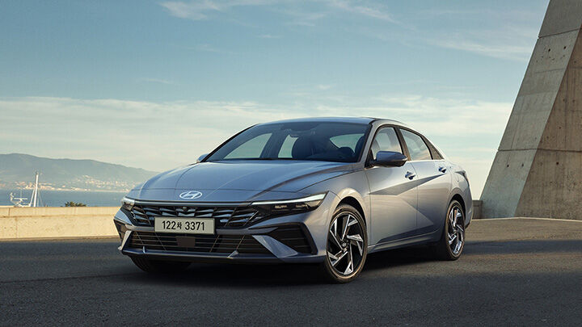
Case of modernity and modernism

Slide 4
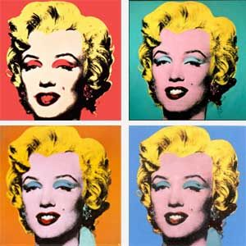
Case of modern art

Slide 5

Case of modern archiecture

Slide 6
Method for researching modern art and architecture
Focusing on Geometric Shape
Never absorbing into Classicism of Ancient, Medieval and Renaissance Art

Slide 7
End

